Slide 1

NEW MONITORS AND OLD MONITORS....
SUBMITTED BY
SUBMITTED TO
Mahafuzur Rahman Talha(4784)n Talha
Prof. Md Mahbub E Noor
University of Barisal – 13th batch
Assistant Professor
Department of CSE – 11th batch
Dept. of Computer science and Engineering
Merit Position - 4784
University of Barisal
Merit Position - 4784

Slide 2

CONTENTS-
What is a monitor?
Evolution of monitors.
More about old monitors(CRT monitors).
Difference between old monitors and new monitors.

Slide 3

What is a monitor?
A monitor is an output device that displays images, videos and other types of information to the user.
Monitors can vary from each other in sizes, resolutions and refresh rates.
So, its quality is often measured by screen size, resolution and refresh rate.

Slide 4
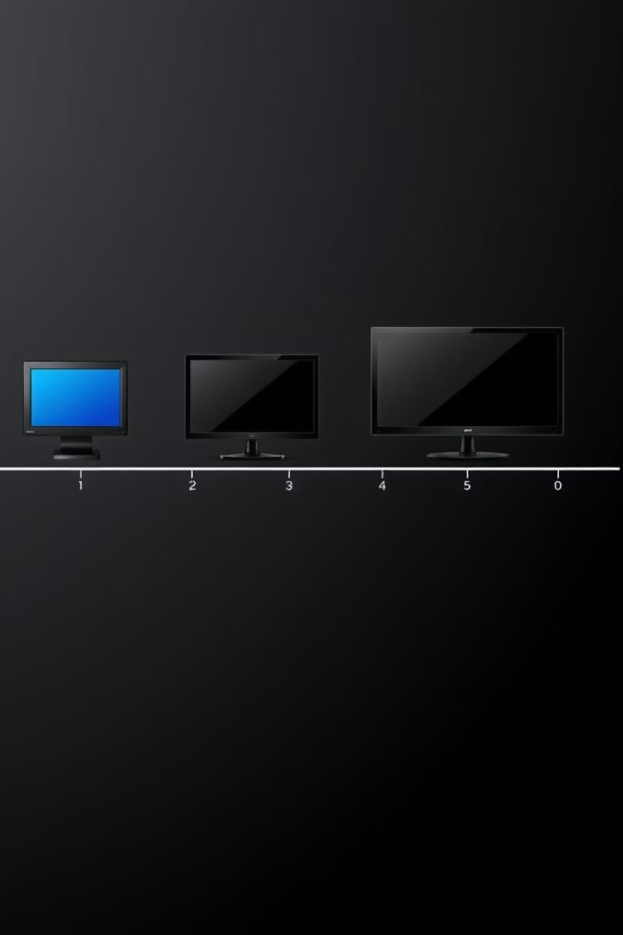
EVOLUTION OF MONITORS
CRT Monitors
CRT (cathode ray tube) monitors, which uses an electron beam to create images on a phosphor-coated screen. It was invented in 1897, making it one of oldest types of monitors.
LCD Monitors
LCD is short for Liquid Crystal Display. It was invented in 1968. And it is still quit popular as it is still being used in various sectors.
OLED Monitors
OLED stands for Organic Light Emitting Diode. Which is the latest technology. And it has faster response time

Slide 5
The changes through-out the evolutions.......
Resolution
Refresh Rate
The resolution of monitors has increased significantly over time. Early monitors had resolutions of 640x480 pixels, while modern monitors can have resolutions of 4K or even higher.
The refresh rate of monitors has also increased over time. Early monitors had refresh rates of 60Hz, while modern monitors can have refresh rates of 144Hz or even higher.
Response Time
The response time of monitors has decreased over time. Early monitors had response times of 16 milliseconds or more, while modern monitors can have response times of 1 millisecond or less.

Slide 6

CRT monitors...
DEFINATION
CRT, Cathode Ray Tube monitors use electron beams and phosphorescent screens to create images. They were popular as It was being used in computers and other devices through 1950s to 2000s.
HOW IT WORKS...
Electrons are shot onto an phosphor-coated screen. And it uses an analog display which displays the image as continuous signals.

Slide 7
CRT monitors...
ADVANTAGES
DISADVANTAGES
It has better color accuracy compared to early LCDs
Large compared to modern flat-screen displays
It's refresh rates provided smooth motion for gaming.
Higher power usage than newer technologies.
It had larger screen size. typically larger than early LCDs.
LCD, LED, and OLED monitors eventually replaced CRTs due to better efficiency.

Slide 8
Difference between old and new monitors
FEATURE
OLD MONITOR
NEW MONITOR
Size
Large and bulky
Thin and lightweight
Resolution
Lower
Higher
Refresh Rate
Lower
Higher
Response Time
Slower
Faster
Power Consumption
Higher
Lower
CONCLUSION : AFTER LEARNING THE DIFFERENCE BETWEEN OLD AND NEW MONITORS WE CAN SAY THAT THE PERFORMANCE OF NEW MONITOR IS WAY BETTER THAN THAT OF NEW MONITORS..

